Slide 1
ANALYSIS ROADMAP
Mental Health Dashboard for Youth in PR (Tableau)
Youth Resilience in PR (shinyapps.io)
DESCRIPTIVE ANALYSIS
Univariate
Numerical
Location
Dispersion
Skewness
Kurtosis
Graphical
Stem-and-leaf
Histograms
Boxplots
Freq. polygons
Tables
Multivariate
Numerical
Covariance corr.
Graphical
Scatterplots
Data plots
INFERENTIAL ANALYSIS
Univariate (testing)
Mean
Difference of Means
Variance
Proportion
ANOVA
Multivariate
Association
Correlation
Regression
Cluster analysis
Correspond. analysis
Discriminant analysis
Factor analysis
MANOVA/MANCOVA
Multilevel
GitHub repo
Ideate, provide context
Collect, organize
Transform
Explore
1
2
3
4
10_ideate.R
Identify business problem
Identity stakeholders
Review prior work
Determine metrics
Determine scope
Write a project plan
Estimate impact, effort, risk
Decide to proceed
Determine responsibilities Determine comm strategy
Identify data sources
Decide on a tech stack
20_ideate.R
Preprocess data
Import data
30_transform.R
Convert data types
Add columns
40_explore.R
Run EDA report
Clean
Select
Analyze
Model
5
6
7
8
50_clean.R
Handle missing data
Handle outliers
60_select.R
Select data to analyze
70_analyze.R
Run EDA reports
Descriptive analysis
Inferential analysis
80_model.R

Slide 2
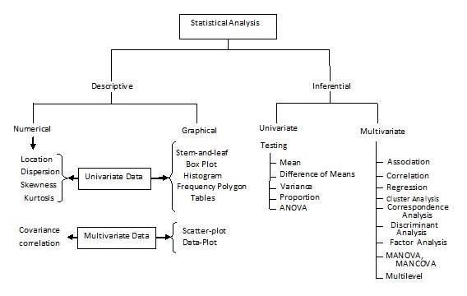
STATISTICAL ANALYSIS: DIFFERENTIAL VS. INFERENTIAL
With Measures and Corresponding R Functions
Descriptive statistics
summarizes and describes data using measures like averages and variability to provide an overview of its main characteristics.
Inferential statistics
uses sample data to make inferences and draw conclusions about a larger population, helping to make predictions and test hypotheses.
Descriptive univariate measures
Moments in stats – R code
Measure of central location. mean()
Measure of dispersion. var()
Measure of asymmetry. skewness() from moments package
Measure of outliers or tailedness. kurtosis() from moments package.
Leptokurtic
Mesokurtic
Platykurtic
Inferential
multivariate measures:
Association: cor.test()
Correlation: cor()
Regression: lm()
Cluster analysis: kmeans()
Correspondence analysis: ca()
Discriminant analysis: lda()
Factor analysis: factanal()
MANOVA/MANCOVA: manova(), mancova()
Multilevel: lme(), glmer()
Inferential univariate measures:
Testing
Mean. mean()
Difference of Means: t.test()
Variance: var()
Proportion: prop.table()
ANOVA: anova()
Additional measures of location:
Average: mean()
Median: median()
Mode: No R function.
Additional measures of dispersion:
STDEV: sd()
Range: range()
IQR: IQR()
Mean Absolute Deviation: mad()
Descriptive multivariate measures
Covariance measures the extent to which two random variables increase or decrease in tandem with each other: cov()
Positive, negative, or zero, reflecting the direction and strength of the relationship.
Non-standardized

Slide 3



YOUTH MENTAL HEALTH
IN PUERTO RICO
Welcome
Understanding Youth Mental Health in Puerto Rico
Importance of Mental Health
Mental well-being is crucial for overall health and development
Addressing youth mental health promotes a brighter future
Overview of Puerto Rico
A United States territory in the Caribbean
Unique cultural heritage and rich history
Youth Mental Health Statistics
Challenges faced by young people in Puerto Rico
Impact of socioeconomic factors on mental health
Prevalence of Mental Health Issues
Statistics on the prevalence of anxiety, depression, and other disorders among Puerto Rican youth
Understanding the scope and magnitude of the issue
Barriers to Accessing Mental Health Services
Limited resources and disparities in healthcare
Cultural stigmas and lack of awareness
Promoting Positive Mental Health
Initiatives and programs addressing youth mental health
Collaborative efforts to raise awareness and provide support
Call to Action
Empowering youth and communities to prioritize mental well-being
Advocating for improved mental health services and resources

Slide 4
IDENTIFY DATA SOURCES
Potential data sources
Instituto de Estadísticas de PR
Childcare.gov: Puerto Rico
Data.gov
Data & Statistics | CDC

